Slide 1
CSC741 Digital Image Processing Presentation 10
Jessica Gallo & Alex Liew

Slide 2
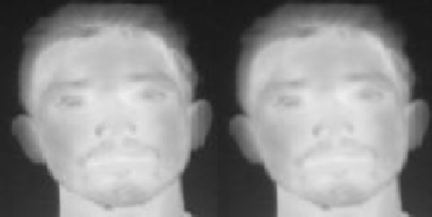
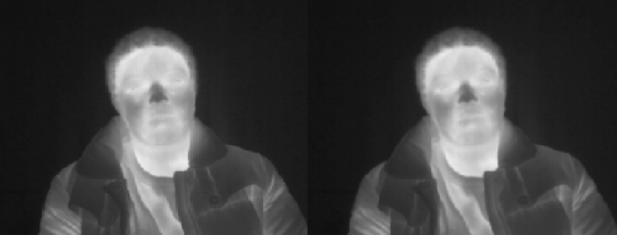
Images
Original
Gaussian Filter
Original
Gaussian Filter

Slide 3
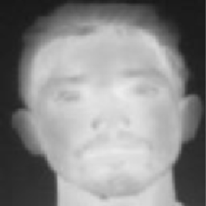
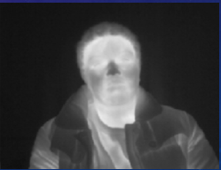

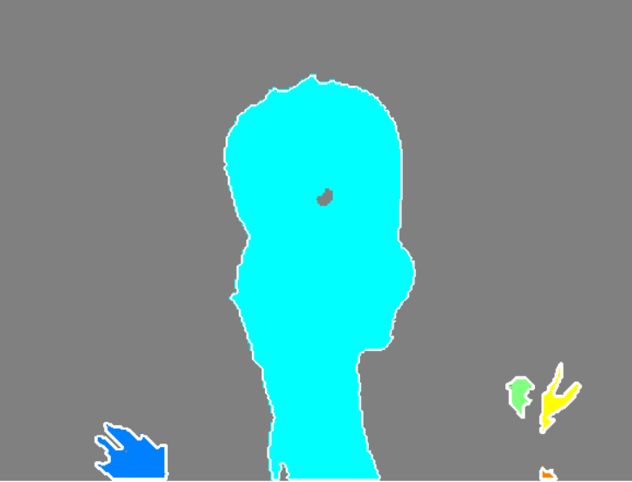
Boundary Extraction & Region Filling

Slide 4
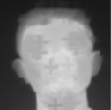

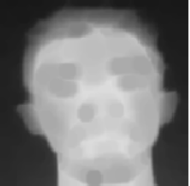
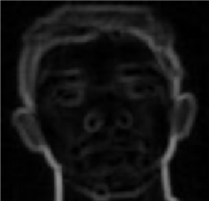
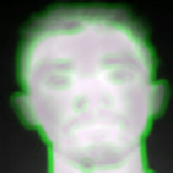
Erosion
Eroded
Eroded-GrayThreshLevel
Using
imerode(binary, strel)
(original image – eroded image)
Gaussian
Best
Eroded
Binary-Eroded
Highlighted Edge (Binary-Eroded)

Slide 5
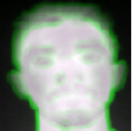

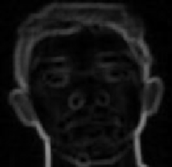
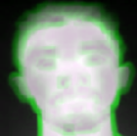
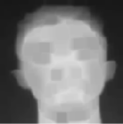
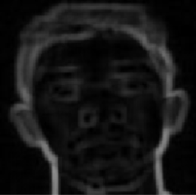
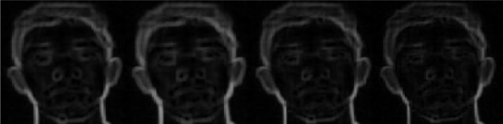
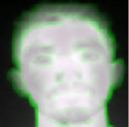

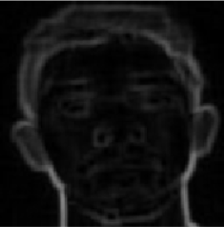
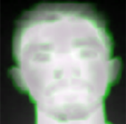
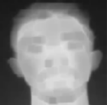
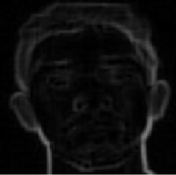
Erosion (2)
Using
imerode(binary, strel)
(original image – eroded image)
Eroded
Original-Eroded
Disk (5.0)
Gaussian
Rectangle [9 9]
Square (7.0)
cube (7.0)
Worst

Slide 6
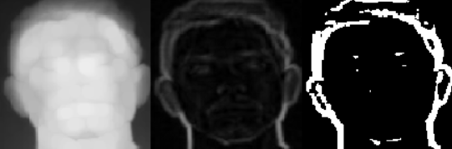
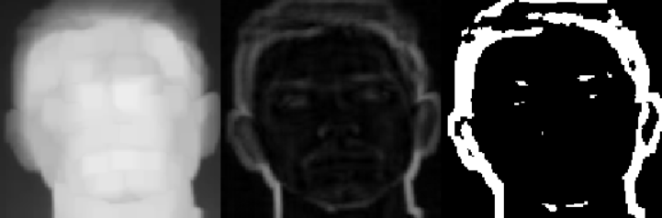
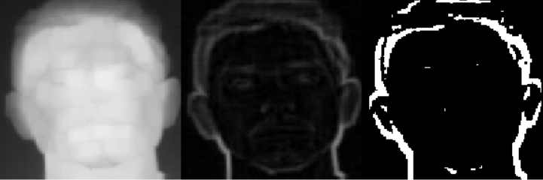
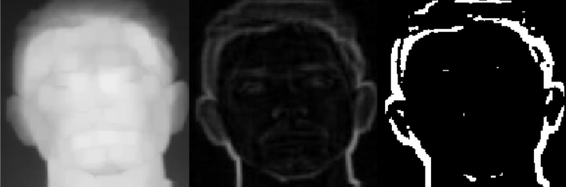
Dilation
Dilated
Edge=Dilated-Original
Edge>Threshold
Disk (5.0)
Gaussian
Rectangle [9 9]
BW = edge > 0.15;
Square (7.0)
cube (7.0)

Slide 7
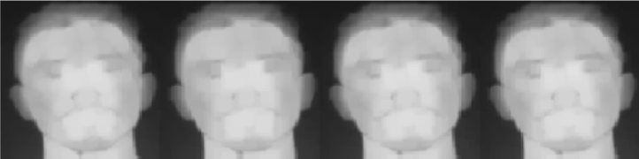
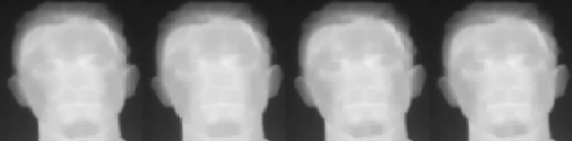
Opening & Closing
Rectangle [9 9]
Square (7.0)
Disk (5.0)
Cube (7.0)
Opening
Gaussian
Closing

Slide 8
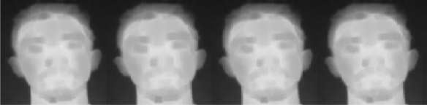
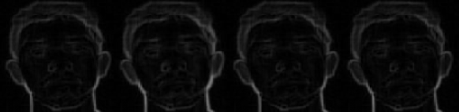
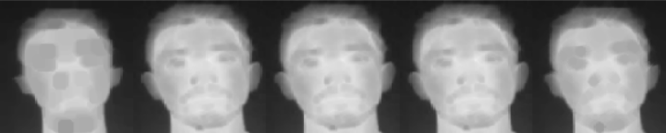
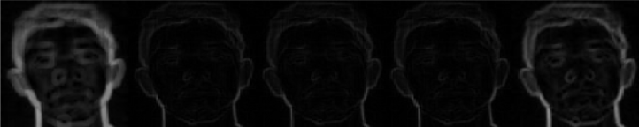
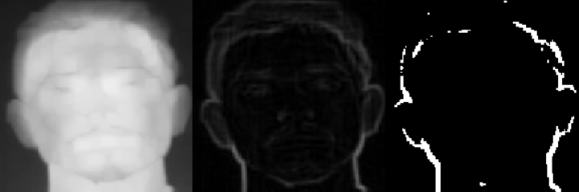
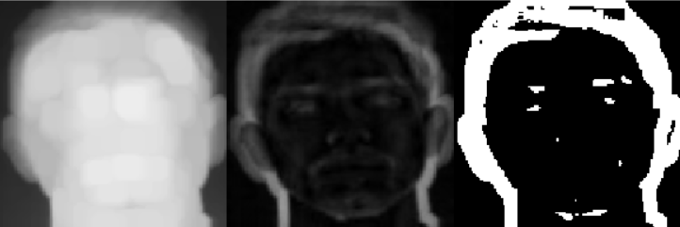
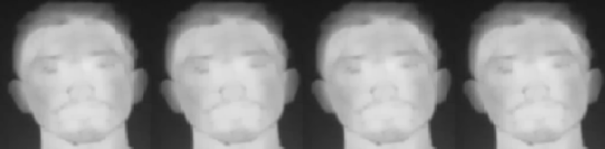
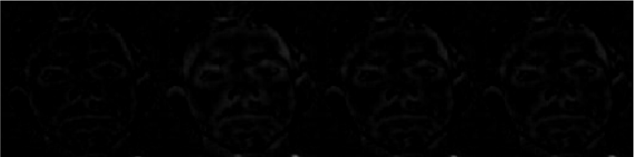
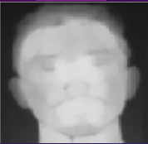
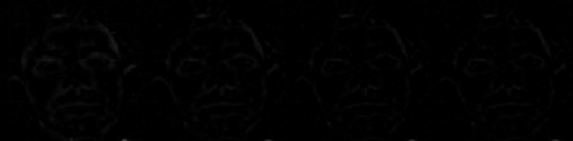
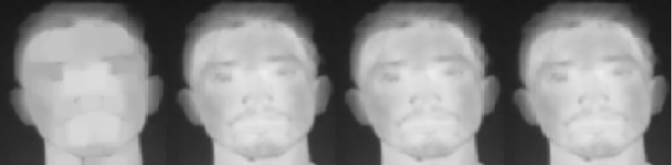
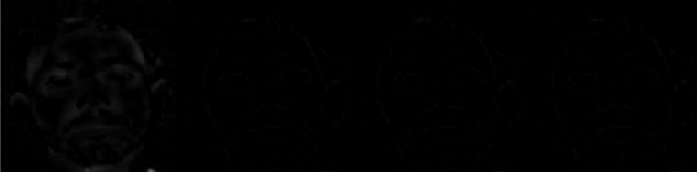
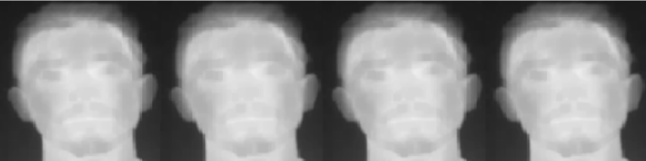

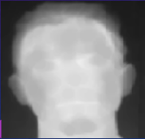
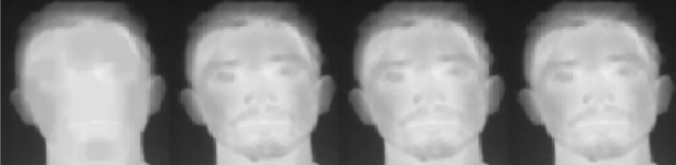
Multiscale Comparison (Disk)
Disk (3.0)
Disk (5.0)
Disk (7.0)
Erosion
Dilation
Opening
Closing

Slide 9
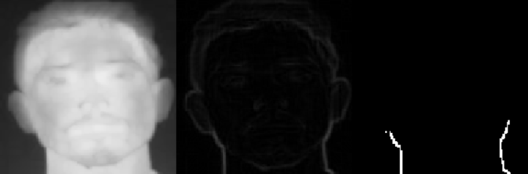
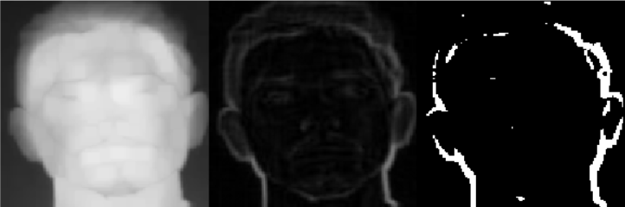
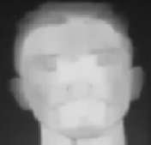
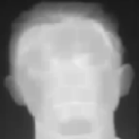
Multiscale Comparison (Rectangle)
Rectangle [3 3]
Rectangle [6 6]
Rectangle [9 9]
Erosion
Dilation
Opening
Closing

Slide 10


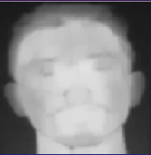
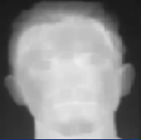
Multiscale Comparison (Square)
Square (3.0)
Square (5.0)
Square (7.0)
Erosion
Dilation
Opening
Closing

Slide 11


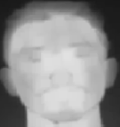
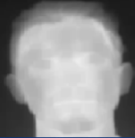
Multiscale Comparison (Cube)
Cube (3.0)
Cube (5.0)
Cube (7.0)
Erosion
Dilation
Opening
Closing

Slide 12
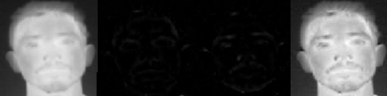



Enhancement
Original
TopHat
BottomHat
Enhanced
Disk (5)
Rectangle [9 9]
Square (7)
Cube (7)

